Slide 1
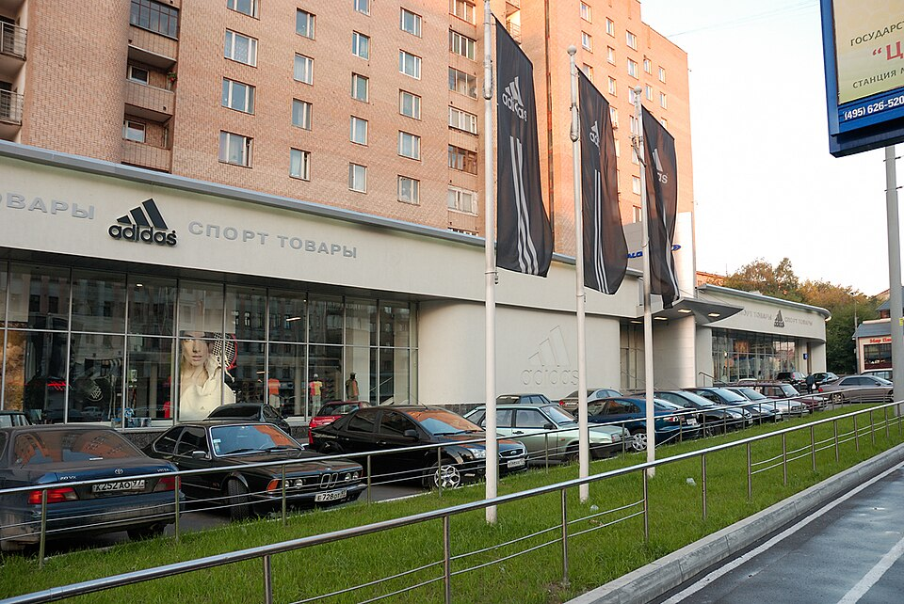
Academic Presentation Cover Sheet
Name:
Student Number:
University:
Module:
Declaration: “I confirm that this presentation is my own work.”
https://commons.wikimedia.org/wiki/File:Adidas_shop_Moscow.jpg
1
Notes:
[Sources]
- Visual: Wikimedia Commons (n.d.) File: Adidas shop Moscow.jpg. Available at: https://commons.wikimedia.org/wiki/File:Adidas_shop_Moscow.jpg (Accessed: 16 April 2026).

Slide 2
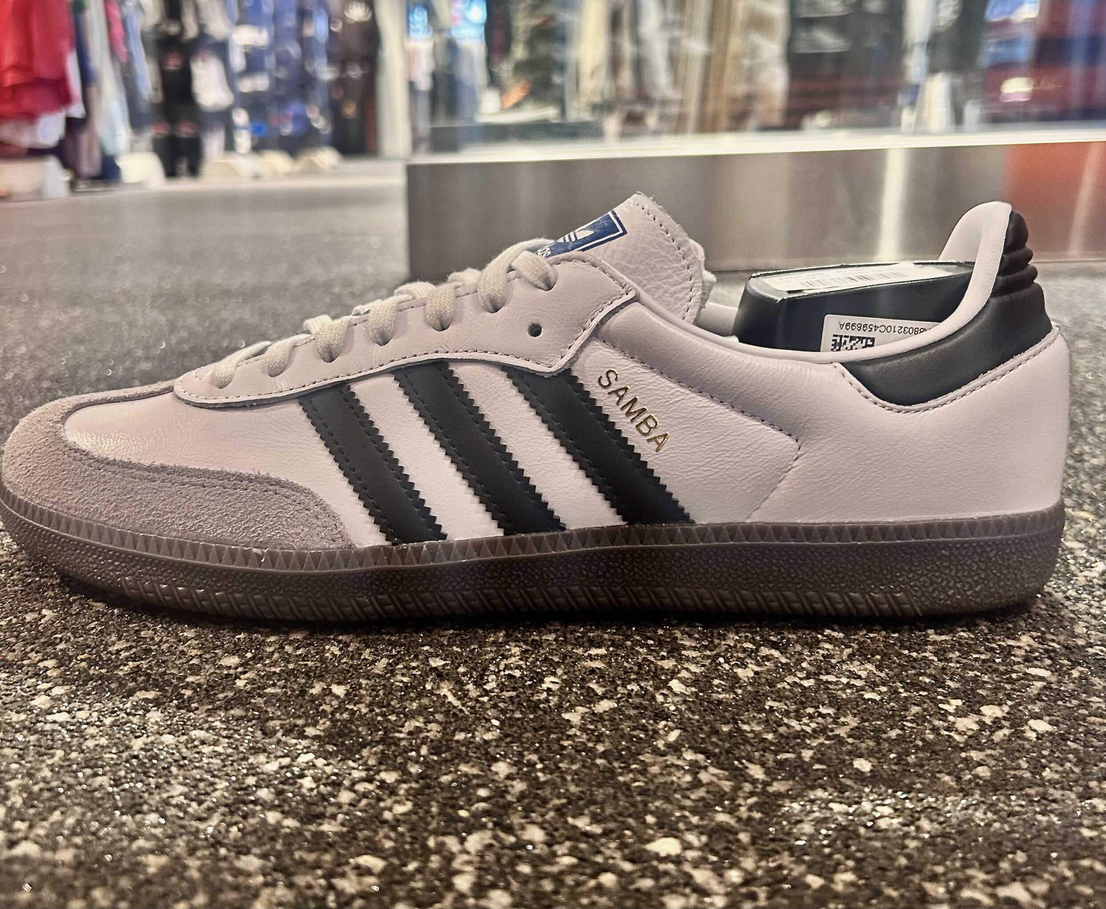
Product placement: how adidas appears across
TV, film and social media
https://commons.wikimedia.org/wiki/File:Adidas_Samba_In_White_March_2024.jpg
Focus: adidas shows how one brand changes meaning by platform (Balasubramanian, 1994; adidas, 2024).
2
Notes:
[Sources]
- Claim: Balasubramanian, S.K. (1994) ‘Beyond Advertising and Publicity: Hybrid Messages and Public Policy Issues’, Journal of Advertising, 23(4), pp. 29–46.
- Claim: adidas (2024a) Product and Marketing. Available at: https://report.adidas-group.com/2024/en/group-management-report-our-company/description-of-business-model/product-and-marketing.html (Accessed: 16 April 2026).
- Visual: Wikimedia Commons (n.d.) File: Adidas Samba In White March 2024.jpg. Available at: https://commons.wikimedia.org/wiki/File:Adidas_Samba_In_White_March_2024.jpg (Accessed: 16 April 2026).

Slide 3
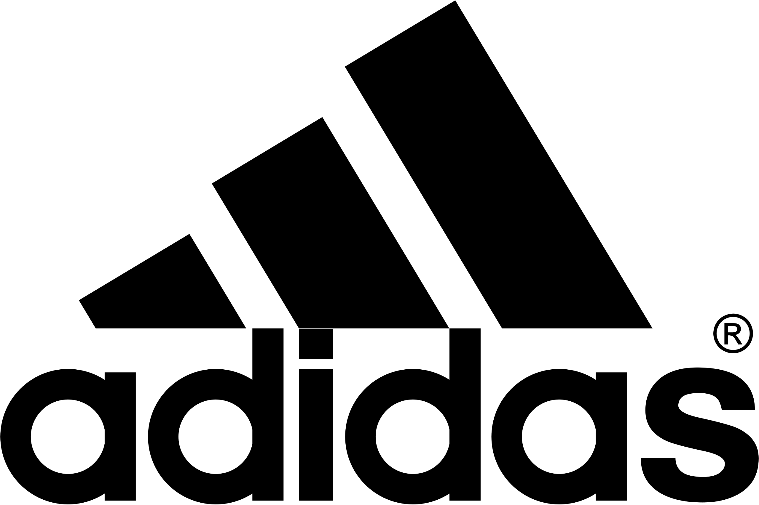
Adidas as a single-brand lens
Why this case study works
• Product placement sits inside content.
• Adidas links sport, style, culture.
• Three stripes signal instantly.
• Shoes and tracksuits travel widely.
• Paid and organic appearances blur.
https://commons.wikimedia.org/wiki/File:Adidas_Logo.svg
Claims: Balasubramanian (1994); Russell (2002); adidas (2024). Visual source below image.
3
Notes:
[Sources]
- Claim: Balasubramanian, S.K. (1994) ‘Beyond Advertising and Publicity: Hybrid Messages and Public Policy Issues’, Journal of Advertising, 23(4), pp. 29–46.
- Claim: Russell, C.A. (2002) ‘Investigating the Effectiveness of Product Placements in Television Shows’, Journal of Consumer Research, 29(3), pp. 306–318.
- Claim: adidas (2024a) Product and Marketing. Available at: https://report.adidas-group.com/2024/en/group-management-report-our-company/description-of-business-model/product-and-marketing.html (Accessed: 16 April 2026).
- Visual: Wikimedia Commons (n.d.) File: Adidas Logo.svg. Available at: https://commons.wikimedia.org/wiki/File:Adidas_Logo.svg (Accessed: 16 April 2026).

Slide 4

TV and livestreamed sport
From adverts to embedded viewing
• TV no longer means ad breaks.
• Adidas cut classic TV ads.
• Friday Night Stripes streamed games.
• 3StripeLive widened girls’ coverage.
• Content viewing replaced interruption.
https://commons.wikimedia.org/wiki/File:Tv_hd.png
Claims: Howland (2017); Williams (2018); Williams (2019). Visual source below image.
4
Notes:
[Sources]
- Claim: Howland, D. (2017) ‘Adidas ditching TV ads to reach Generation Z on mobile’, Marketing Dive, 16 March. Available at: https://www.marketingdive.com/news/adidas-ditching-tv-ads-to-reach-generation-z-on-mobile/438291/ (Accessed: 16 April 2026).
- Claim: Williams, R. (2018) ‘Adidas signs with Twitter to livestream high school football’, Marketing Dive, 15 August. Available at: https://www.marketingdive.com/news/adidas-signs-with-twitter-to-livestream-high-school-football/530114/ (Accessed: 16 April 2026).
- Claim: Williams, R. (2019a) ‘Adidas taps Twitter livestream series to boost female athletes’, Marketing Dive, 8 March. Available at: https://www.marketingdive.com/news/adidas-taps-twitter-livestream-series-to-boost-female-athletes/550041/ (Accessed: 16 April 2026).
- Visual: Wikimedia Commons (n.d.) File: Tv hd.png. Available at: https://commons.wikimedia.org/wiki/File:Tv_hd.png (Accessed: 16 April 2026).

Slide 5
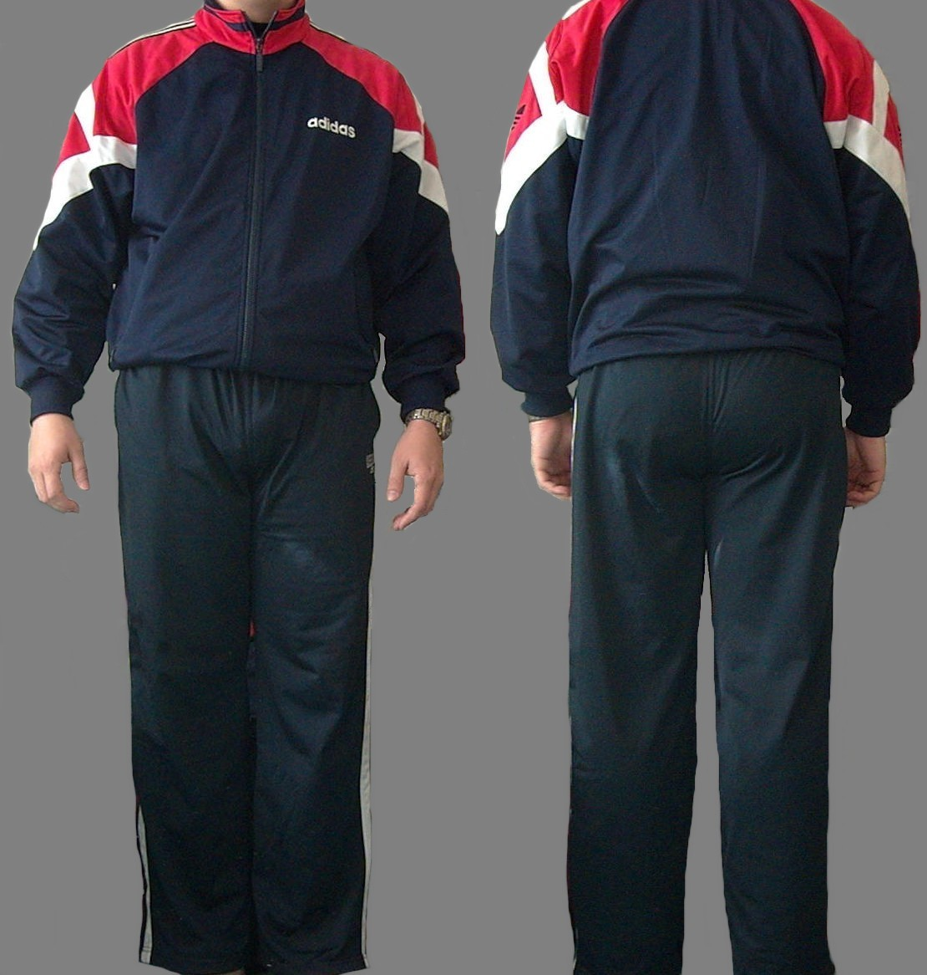
Film: style, memory, symbolism
Cinema turns products into character
• Trainspotting used burgundy Sambas.
• Tenenbaums used red tracksuits.
• Costume made adidas shorthand.
• Film gave products cult status.
• Meanings outlived release windows.
https://commons.wikimedia.org/wiki/File:Sports_suit.jpg
Claims: Freeman (2023); Cheung (2024); Vogue (2020). Visual source below image.
5
Notes:
[Sources]
- Claim: Freeman, H. (2023) ‘Now Sienna Miller Steps Out In A Trending Trainer’, British Vogue, 20 April. Available at: https://www.vogue.co.uk/article/sienna-miller-adidas-samba-trainers (Accessed: 16 April 2026).
- Claim: Cheung, A. (2024) ‘A rundown of the best trainers in movie history’, British GQ, 28 March. Available at: https://www.gq-magazine.co.uk/fashion/article/best-trainers-in-films (Accessed: 16 April 2026).
- Claim: Vogue (2020) ‘On His 51st Birthday, Revisit Wes Anderson’s Dreamiest Onscreen Style Moments’, Vogue, 1 May. Available at: https://www.vogue.com/article/wes-anderson-birthday-best-film-style-moments (Accessed: 16 April 2026).
- Visual: Wikimedia Commons (n.d.) File: Sports suit.jpg. Available at: https://commons.wikimedia.org/wiki/File:Sports_suit.jpg (Accessed: 16 April 2026).

Slide 6
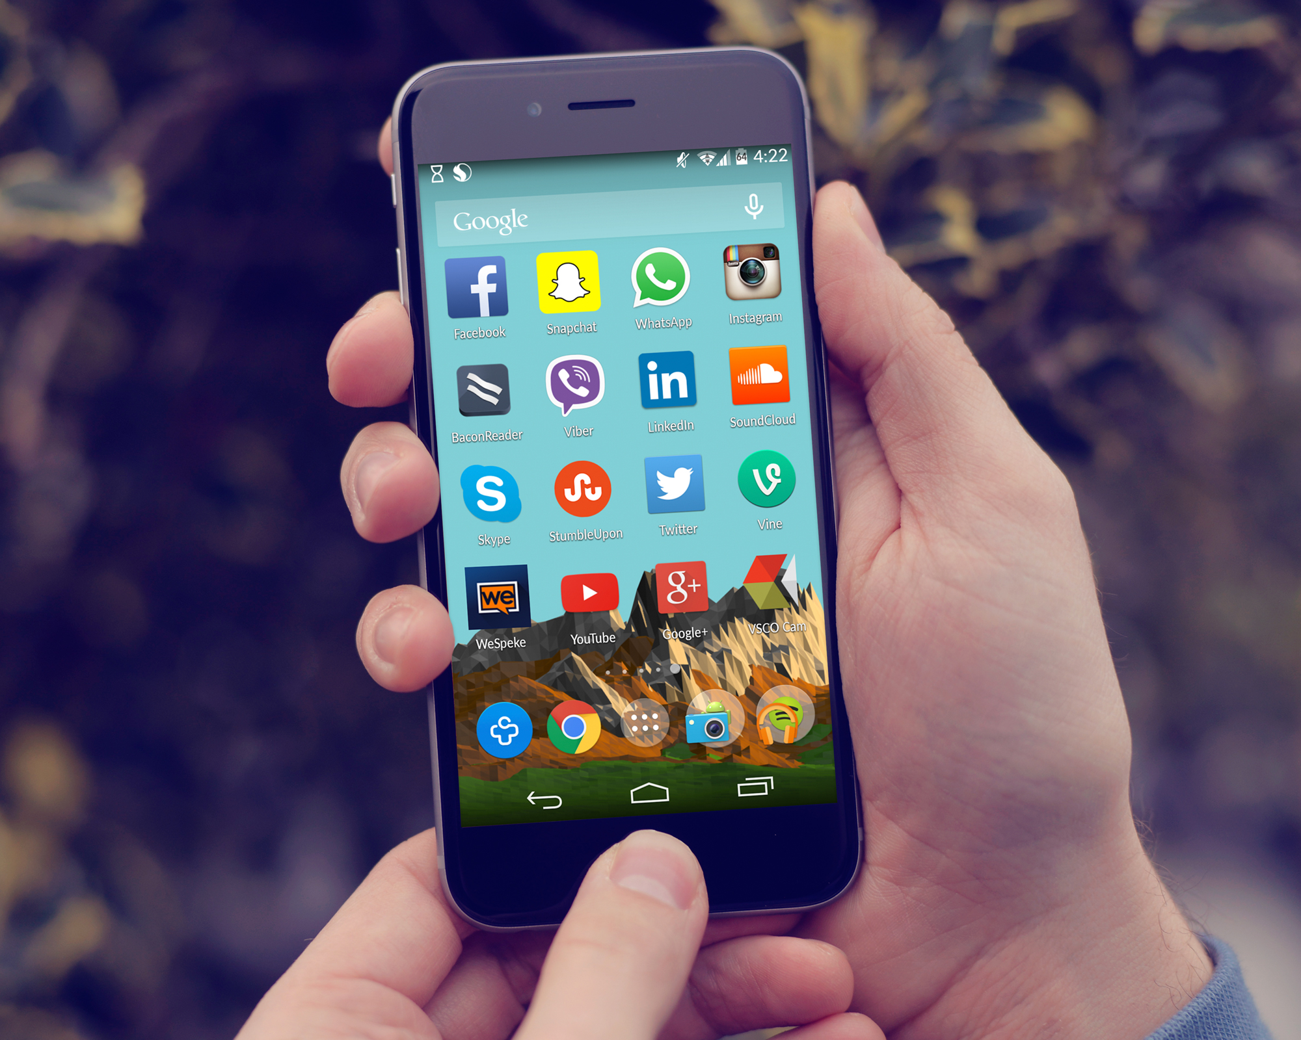
Social media: creator closeness
Short-form content speeds conversion
• P.O.D. launched via Instagram Stories.
• Music video held product center-frame.
• Glover made five adidas shorts.
• Shoppable tags shortened purchase paths.
• Creators blended story and commerce.
https://commons.wikimedia.org/wiki/File:Social_media_Icons_On_The_Home_Screen_of_an_Android_Phone.jpg
Claims: Williams (2018, 2019); adidas (2024). Visual source below image.
6
Notes:
[Sources]
- Claim: Williams, R. (2018b) ‘Adidas drops new shoe in Instagram Stories music video’, Marketing Dive, 19 October. Available at: https://www.marketingdive.com/news/adidas-launches-new-shoe-in-instagram-stories-music-video/540066/ (Accessed: 16 April 2026).
- Claim: Williams, R. (2019b) ‘Adidas, Donald Glover drop short films for new shoe deal’, Marketing Dive, 22 April. Available at: https://www.marketingdive.com/news/adidas-donald-glover-drop-short-films-for-new-shoe-deal/553107/ (Accessed: 16 April 2026).
- Claim: adidas (2024b) Strategy. Available at: https://report.adidas-group.com/2024/en/group-management-report-sustainability-statement/esrs-2-general-disclosures/strategy.html (Accessed: 16 April 2026).
- Visual: Wikimedia Commons (n.d.) File: Social media Icons On The Home Screen of an Android Phone.jpg. Available at: https://commons.wikimedia.org/wiki/File:Social_media_Icons_On_The_Home_Screen_of_an_Android_Phone.jpg (Accessed: 16 April 2026).

Slide 7
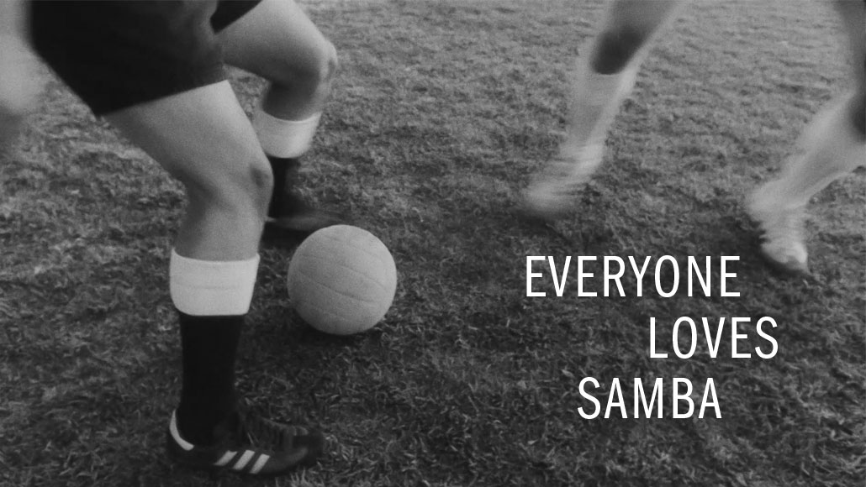
Why adidas fits so well
Brand assets that travel
• Logos stay readable on-screen.
• Heritage models carry subcultural meaning.
• Sport products become lifestyle symbols.
• Strong fit boosts authenticity.
• Context changes audience interpretation.
https://report.adidas-group.com/2023/en/_assets/gallery/mag-samba-hero.jpg
Claims: Russell (2002); Babin et al. (2021); adidas (2024). Visual source below image.
7
Notes:
[Sources]
- Claim: Russell, C.A. (2002) ‘Investigating the Effectiveness of Product Placements in Television Shows’, Journal of Consumer Research, 29(3), pp. 306–318.
- Claim: Babin, B.J. et al. (2021) ‘The effectiveness of brand placements: A meta-analytic synthesis’, International Journal of Research in Marketing, 38(4), pp. 1017–1033.
- Claim: adidas (2024a) Product and Marketing. Available at: https://report.adidas-group.com/2024/en/group-management-report-our-company/description-of-business-model/product-and-marketing.html (Accessed: 16 April 2026).
- Visual: adidas Annual Report 2023 (n.d.) ‘mag-samba-hero’. Available at: https://report.adidas-group.com/2023/en/_assets/gallery/mag-samba-hero.jpg (Accessed: 16 April 2026).

Slide 8
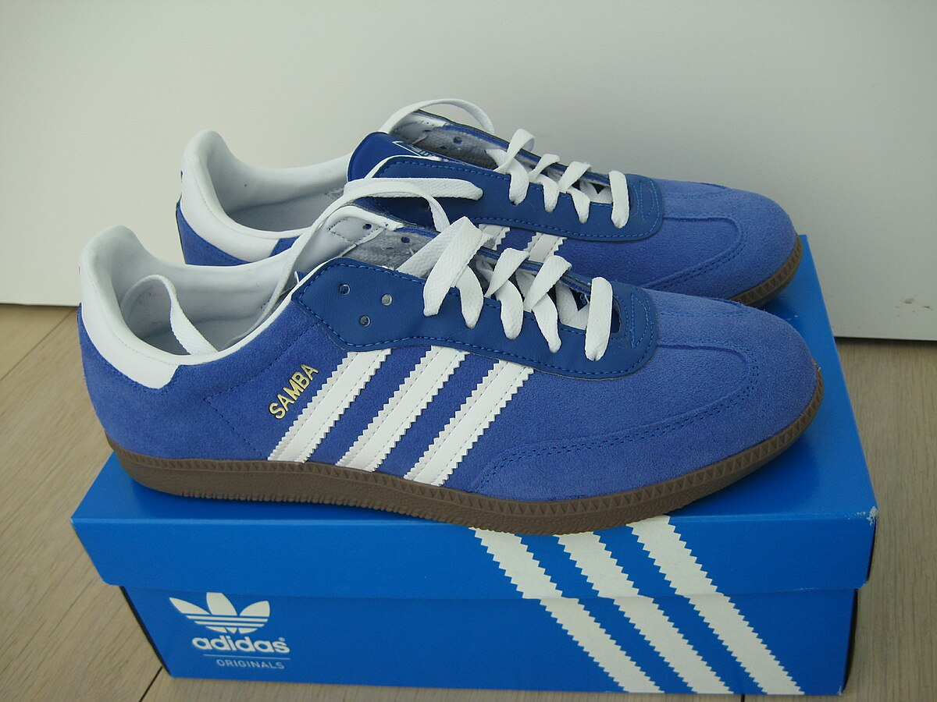
Consumer impact and limits
What research suggests
• Placements lift awareness and salience.
• Attitude effects stay smaller.
• Repetition matters more than prominence.
• Natural fit improves recall.
• Forced use can backfire.
https://commons.wikimedia.org/wiki/File:Blue_suede_samba.JPG
Claims: Babin et al. (2021); Russell (2002). Visual source below image.
8
Notes:
[Sources]
- Claim: Babin, B.J. et al. (2021) ‘The effectiveness of brand placements: A meta-analytic synthesis’, International Journal of Research in Marketing, 38(4), pp. 1017–1033.
- Claim: Russell, C.A. (2002) ‘Investigating the Effectiveness of Product Placements in Television Shows’, Journal of Consumer Research, 29(3), pp. 306–318.
- Visual: Wikimedia Commons (n.d.) File: Blue suede samba.JPG. Available at: https://commons.wikimedia.org/wiki/File:Blue_suede_samba.JPG (Accessed: 16 April 2026).

Slide 9
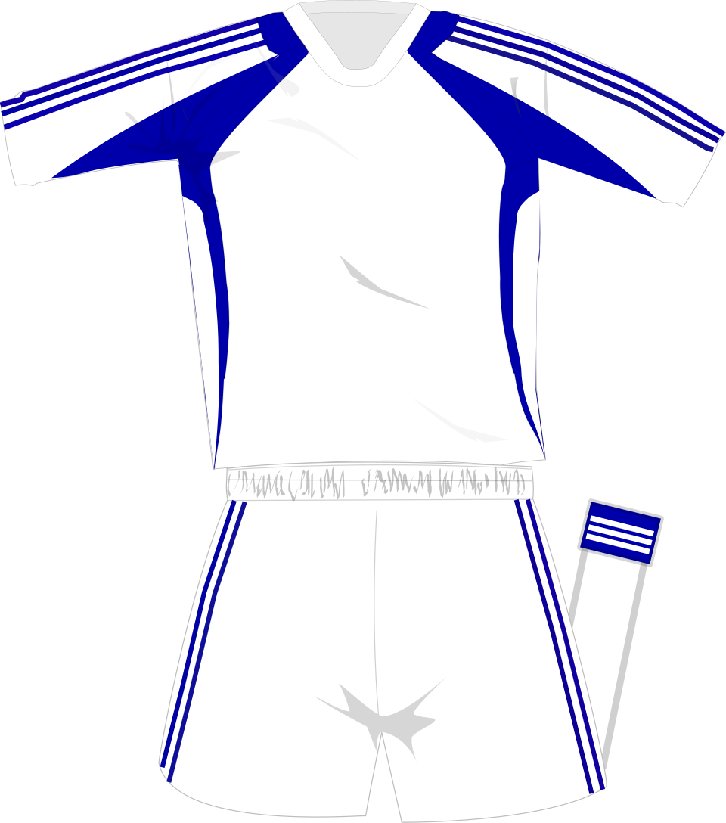
Ethics and conclusion
Visibility needs transparency
• Influencer content needs clear labels.
• Young users may miss intent.
• Adidas should disclose paid creators.
• Best results come from fit.
• One brand, different screen effects.
https://commons.wikimedia.org/wiki/File:Adidas_generic_whiteblue_kit_2008.svg
Claims: FTC (2019); ASA (2023); Fernández-Gómez et al. (2024). Visual source below image.
9
Notes:
[Sources]
- Claim: Federal Trade Commission (2019) Disclosures 101 for Social Media Influencers. Available at: https://www.ftc.gov/system/files/documents/plain-language/1001a-influencer-guide-508_1.pdf (Accessed: 16 April 2026).
- Claim: Advertising Standards Authority (2023) Influencers’ guide to making clear that ads are ads. Available at: https://www.asa.org.uk/static/790d2e01-e3f8-4fea-b3c99ef91a9f04dc/Influencerguidance2023v4-FINAL.pdf (Accessed: 16 April 2026).
- Claim: Fernández-Gómez, E., Neira Placer, P. and Feijoo Fernández, B. (2024) ‘New mobile advertising formats targeting young audiences’, Humanities and Social Sciences Communications, 11, 1488.
- Visual: Wikimedia Commons (n.d.) File: Adidas generic whiteblue kit 2008.svg. Available at: https://commons.wikimedia.org/wiki/File:Adidas_generic_whiteblue_kit_2008.svg (Accessed: 16 April 2026).

Slide 10
References
Adidas (2024a) Product and marketing. Annual Report 2024. Available at: https://report.adidas-group.com/2024/en/group-management-report-our-company/description-of-business-model/product-and-marketing.html (Accessed: 16 April 2026).
Adidas (2024b) Strategy. Annual Report 2024. Available at: https://report.adidas-group.com/2024/en/group-management-report-sustainability-statement/esrs-2-general-disclosures/strategy.html (Accessed: 16 April 2026).
Advertising Standards Authority (2023) Influencers’ guide to making clear that ads are ads. Available at: https://www.asa.org.uk/static/790d2e01-e3f8-4fea-b3c99ef91a9f04dc/Influencerguidance2023v4-FINAL.pdf (Accessed: 16 April 2026).
Babin, B.J., Herrmann, J.-L., Kacha, M. and Babin, L.A. (2021) ‘The effectiveness of brand placements: A meta-analytic synthesis’, International Journal of Research in Marketing, 38(4), pp. 1017–1033. Available at: https://doi.org/10.1016/j.ijresmar.2021.01.003 (Accessed: 16 April 2026).
Balasubramanian, S.K. (1994) ‘Beyond advertising and publicity: Hybrid messages and public policy issues’, Journal of Advertising, 23(4), pp. 29–46.
Cheung, A. (2024) ‘A rundown of the best trainers in movie history’, British GQ, 28 March. Available at: https://www.gq-magazine.co.uk/fashion/article/best-trainers-in-films (Accessed: 16 April 2026).
Cotonou, C. (2022) ‘The rake style guide: A page from the Tenenbaums’, The Rake, October. Available at: https://therake.com/default/stories/the-rake-style-guide-a-page-from-the-tenenbaums (Accessed: 16 April 2026).
Federal Trade Commission (2019) Disclosures 101 for social media influencers. Available at: https://www.ftc.gov/system/files/documents/plain-language/1001a-influencer-guide-508_1.pdf (Accessed: 16 April 2026).
Fernández-Gómez, E., Neira Placer, P. and Feijoo Fernández, B. (2024) ‘New mobile advertising formats targeting young audiences: An analysis of advertainment and influencers’ role in perception and understanding’, Humanities and Social Sciences Communications, 11, 1488. Available at: https://doi.org/10.1057/s41599-024-04003-3 (Accessed: 16 April 2026).
Freeman, H. (2023) ‘Now Sienna Miller steps out in a trending trainer’, British Vogue, 20 April. Available at: https://www.vogue.co.uk/article/sienna-miller-adidas-samba-trainers (Accessed: 16 April 2026).
Howland, D. (2017) ‘Adidas ditching TV ads to reach Generation Z on mobile’, Marketing Dive, 16 March. Available at: https://www.marketingdive.com/news/adidas-ditching-tv-ads-to-reach-generation-z-on-mobile/438291/ (Accessed: 16 April 2026).
Russell, C.A. (2002) ‘Investigating the effectiveness of product placements in television shows: The role of modality and plot connection congruence on brand memory and attitude’, Journal of Consumer Research, 29(3), pp. 306–318. Available at: https://doi.org/10.1086/344432 (Accessed: 16 April 2026).
Vogue (2020) ‘On his 51st birthday, revisit Wes Anderson’s dreamiest onscreen style moments’, Vogue, 1 May. Available at: https://www.vogue.com/article/wes-anderson-birthday-best-film-style-moments (Accessed: 16 April 2026).
Williams, R. (2018a) ‘Adidas signs with Twitter to livestream high school football’, Marketing Dive, 15 August. Available at: https://www.marketingdive.com/news/adidas-signs-with-twitter-to-livestream-high-school-football/530114/ (Accessed: 16 April 2026).
Williams, R. (2018b) ‘Adidas drops new shoe in Instagram stories music video’, Marketing Dive, 19 October. Available at: https://www.marketingdive.com/news/adidas-launches-new-shoe-in-instagram-stories-music-video/540066/ (Accessed: 16 April 2026).
Williams, R. (2019a) ‘Adidas taps Twitter livestream series to boost female athletes’, Marketing Dive, 8 March. Available at: https://www.marketingdive.com/news/adidas-taps-twitter-livestream-series-to-boost-female-athletes/550041/ (Accessed: 16 April 2026).
Williams, R. (2019b) ‘Adidas, Donald Glover drop short films for new shoe deal’, Marketing Dive, 22 April. Available at: https://www.marketingdive.com/news/adidas-donald-glover-drop-short-films-for-new-shoe-deal/553107/ (Accessed: 16 April 2026).
Wikimedia Commons (n.d.) File: Adidas shop Moscow.jpg. Available at: https://commons.wikimedia.org/wiki/File:Adidas_shop_Moscow.jpg (Accessed: 16 April 2026).
Wikimedia Commons (n.d.) File: Adidas Samba in white March 2024.jpg. Available at: https://commons.wikimedia.org/wiki/File:Adidas_Samba_In_White_March_2024.jpg (Accessed: 16 April 2026).
Wikimedia Commons (n.d.) File: Adidas logo.svg. Available at: https://commons.wikimedia.org/wiki/File:Adidas_Logo.svg (Accessed: 16 April 2026).
Wikimedia Commons (n.d.) File: TV HD.png. Available at: https://commons.wikimedia.org/wiki/File:Tv_hd.png (Accessed: 16 April 2026).
Wikimedia Commons (n.d.) File: Sports suit.jpg. Available at: https://commons.wikimedia.org/wiki/File:Sports_suit.jpg (Accessed: 16 April 2026).
Wikimedia Commons (n.d.) File: Social media icons on the home screen of an Android phone.jpg. Available at: https://commons.wikimedia.org/wiki/File:Social_media_Icons_On_The_Home_Screen_of_an_Android_Phone.jpg (Accessed: 16 April 2026).
Adidas (n.d.) Mag-samba-hero. Available at: https://report.adidas-group.com/2023/en/_assets/gallery/mag-samba-hero.jpg (Accessed: 16 April 2026).
Wikimedia Commons (n.d.) File: Blue suede samba.jpg. Available at: https://commons.wikimedia.org/wiki/File:Blue_suede_samba.JPG (Accessed: 16 April 2026).
Wikimedia Commons (n.d.) File: Adidas generic whiteblue kit 2008.svg. Available at: https://commons.wikimedia.org/wiki/File:Adidas_generic_whiteblue_kit_2008.svg (Accessed: 16 April 2026).
10
Notes:
[Sources]
- References compiled from sources cited across slides 2–9.

